Slide 1
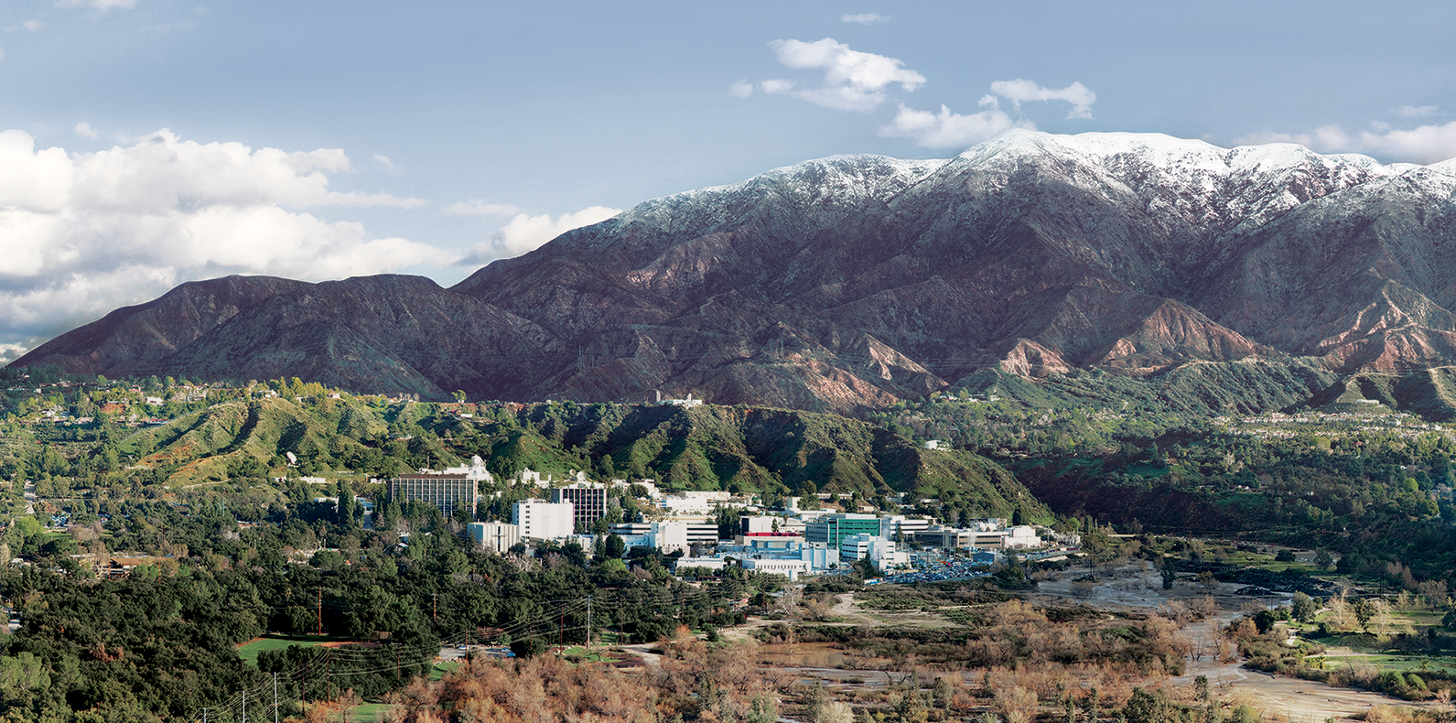
1. Introduction to Imaging Spectroscopy
Dr. David R. Thompson
Jet Propulsion Laboratory, Imaging Spectroscopy Group
July 20, 2019

Slide 2
Goals for this module
Interpret imaging spectrometer measurements
Open and interrogate spectral cube images
Understand differences between spectroscopic and image domain analyses

Slide 3
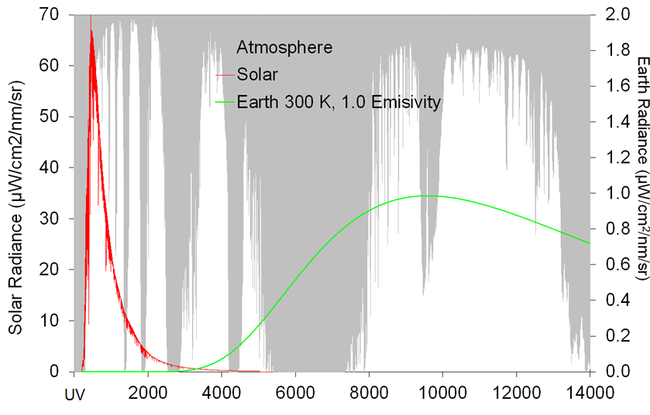
Dramatis Persone
Wavelength (nm)

Slide 4
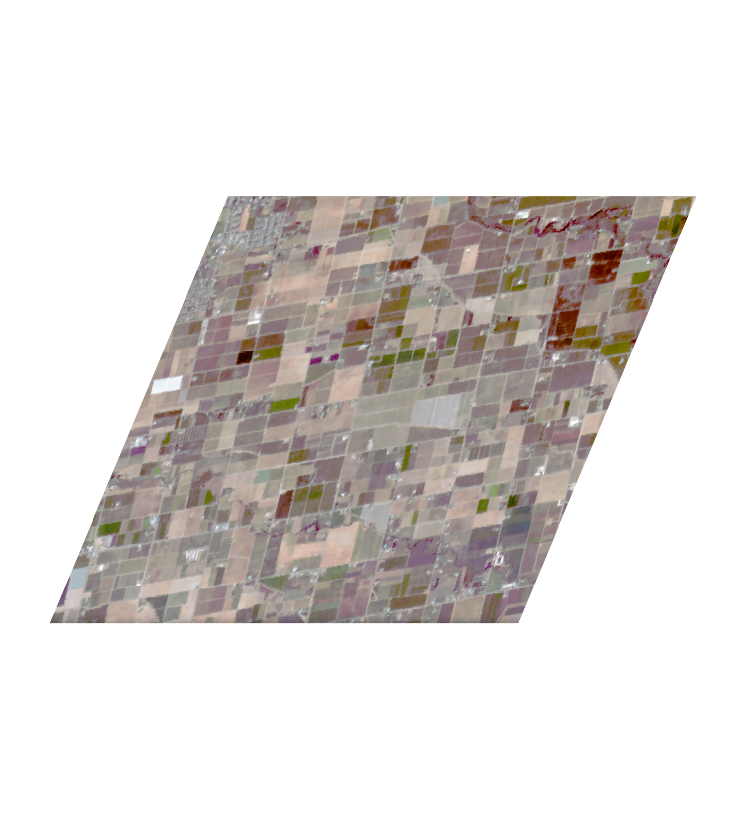
Measurement process – 100s of parallel spectrometers
Detector Array
Spectrometer
Slit
Telescope

Slide 5

From radiance to surface reflectance
Instrument
Scattering
Absorption
Atmosphere
Reflection
Surface

Slide 6
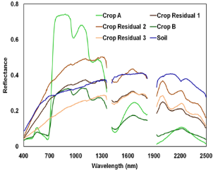
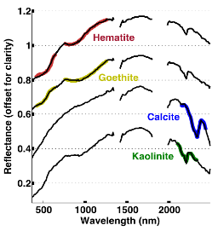
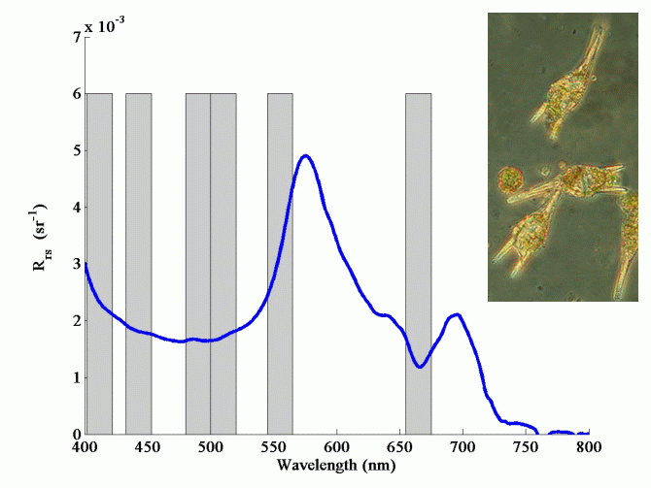
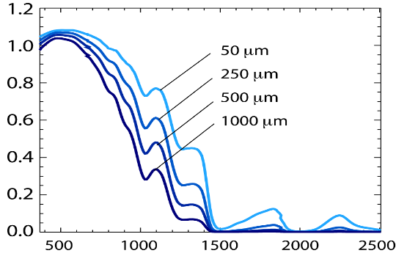
Agriculture and Terrestrial Ecosystems
Geology, Soils, Surface Composition
Coastal and Inland Waters
Snow and Ice
Wavelength (nm)

Slide 7
Example: species maps
Courtesy Dar Roberts, UCSB

Slide 8
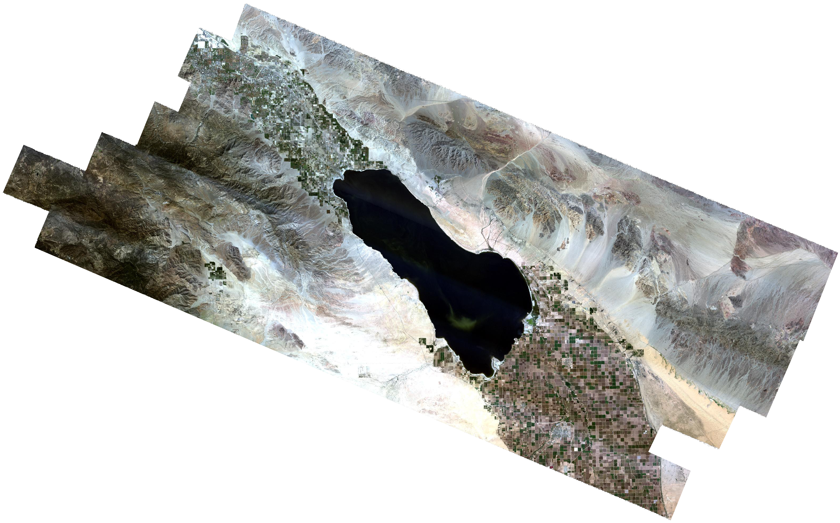
Example: Geologic Mapping via absorption fits
Mineral absorption
Surface Reflectance
(Salton Sea, CA)

Slide 9
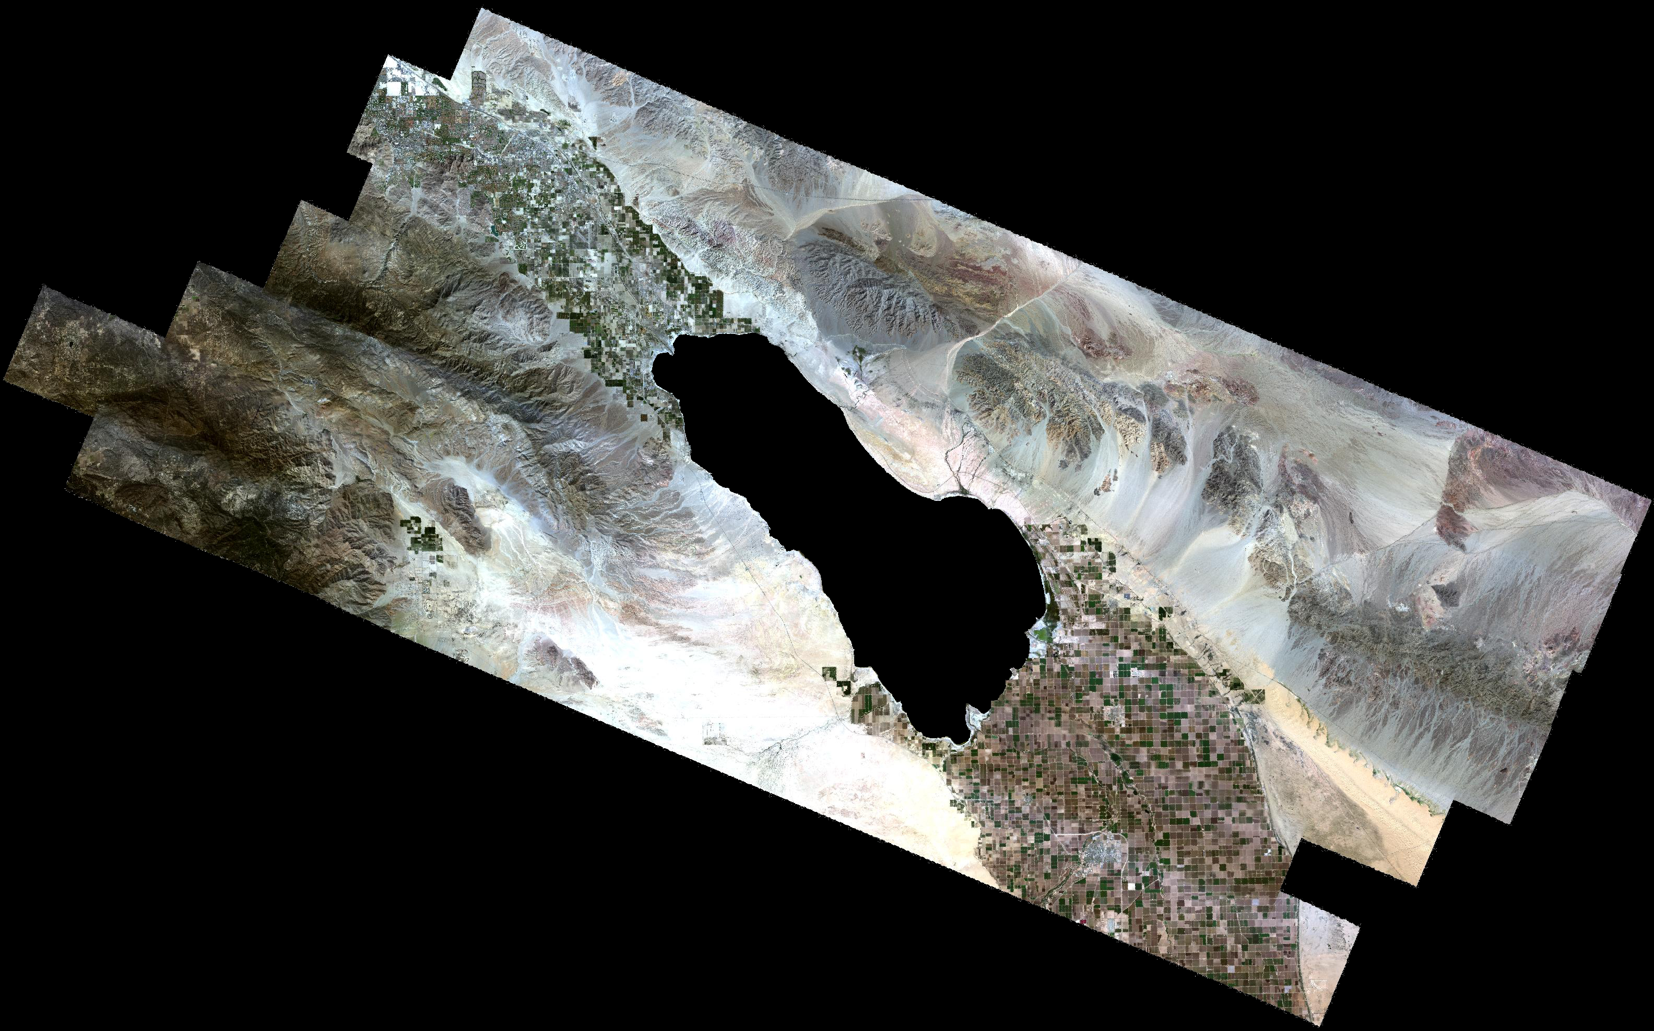
Salton Sea, CA (AVIRIS instrument)
Courtesy NASA/JPL/Roger Clark

Slide 10
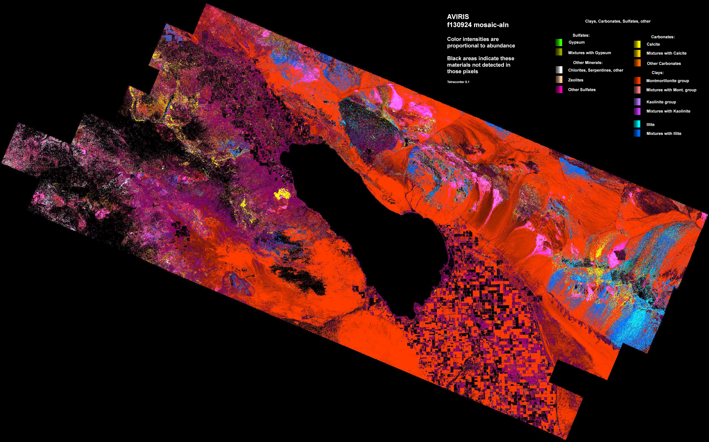
Salton Sea, CA (AVIRIS instrument)
Courtesy NASA / JPL / USGS / R. Clark
Salton Sea
Mineral Map
50km
Courtesy NASA/JPL/Roger Clark

Slide 11
Example: water quality mapping
Courtesy NASA / JPL / C. Fichot

Slide 12
Example: water quality mapping
Turbidity
Chlorophyll
Courtesy NASA / JPL / C. Fichot

Slide 13
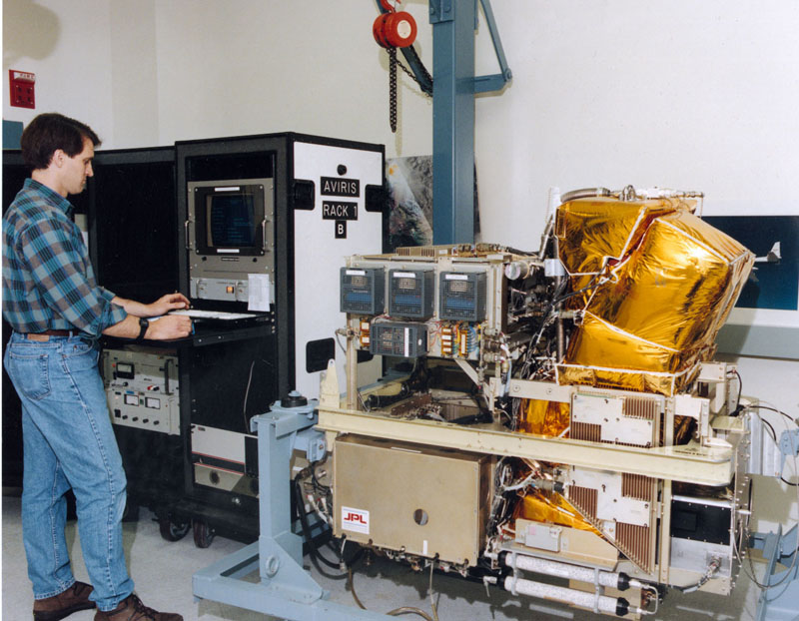
AVIRIS Classic (JPL, 1986)
airbornescience.nasa.gov

Slide 14
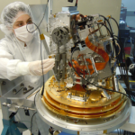
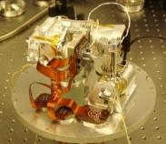
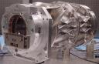
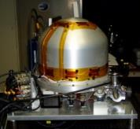
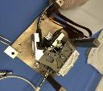
Recent instruments
AVIRIS-NG 2012
UCIS 2013
CWIS 2015
PRISM 2012
ESWIRS 2014

Slide 15
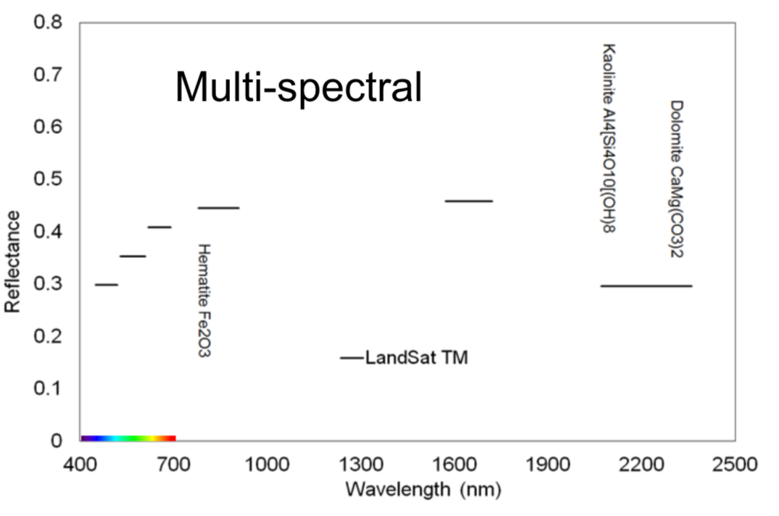
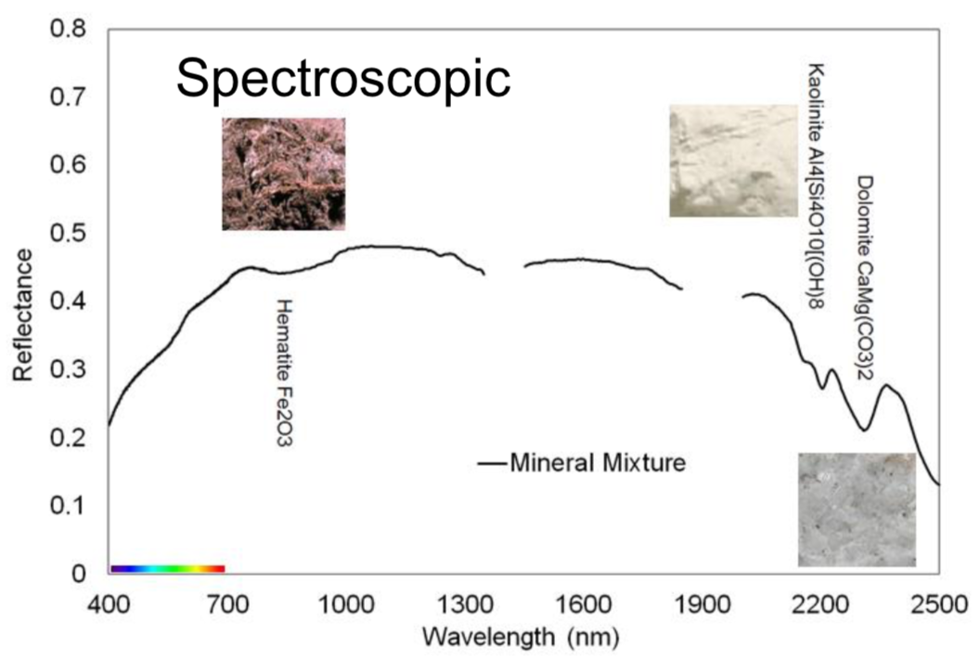
Imaging spectroscopy vs. multiband analysis
Images courtesy Robert O. Green, JPL
Multiband |  | Imaging Spectroscopy
Typically built with optical filters |  | Uses dispersive elements (e.g. gratings)
1-10s of bands |  | 100s of channels
Image-space (morphological) analyses |  | Spectroscopy using each pixel independently
Band math, thresholds, trees |  | Feature fitting and shape matching
Often mathematically underdetermined |  | Often mathematically overdetermined
Analyses are often qualitative |  | Quantitative measurement with uncertainties
Empirical modeling |  | Empirical or physics-based modeling

Slide 16
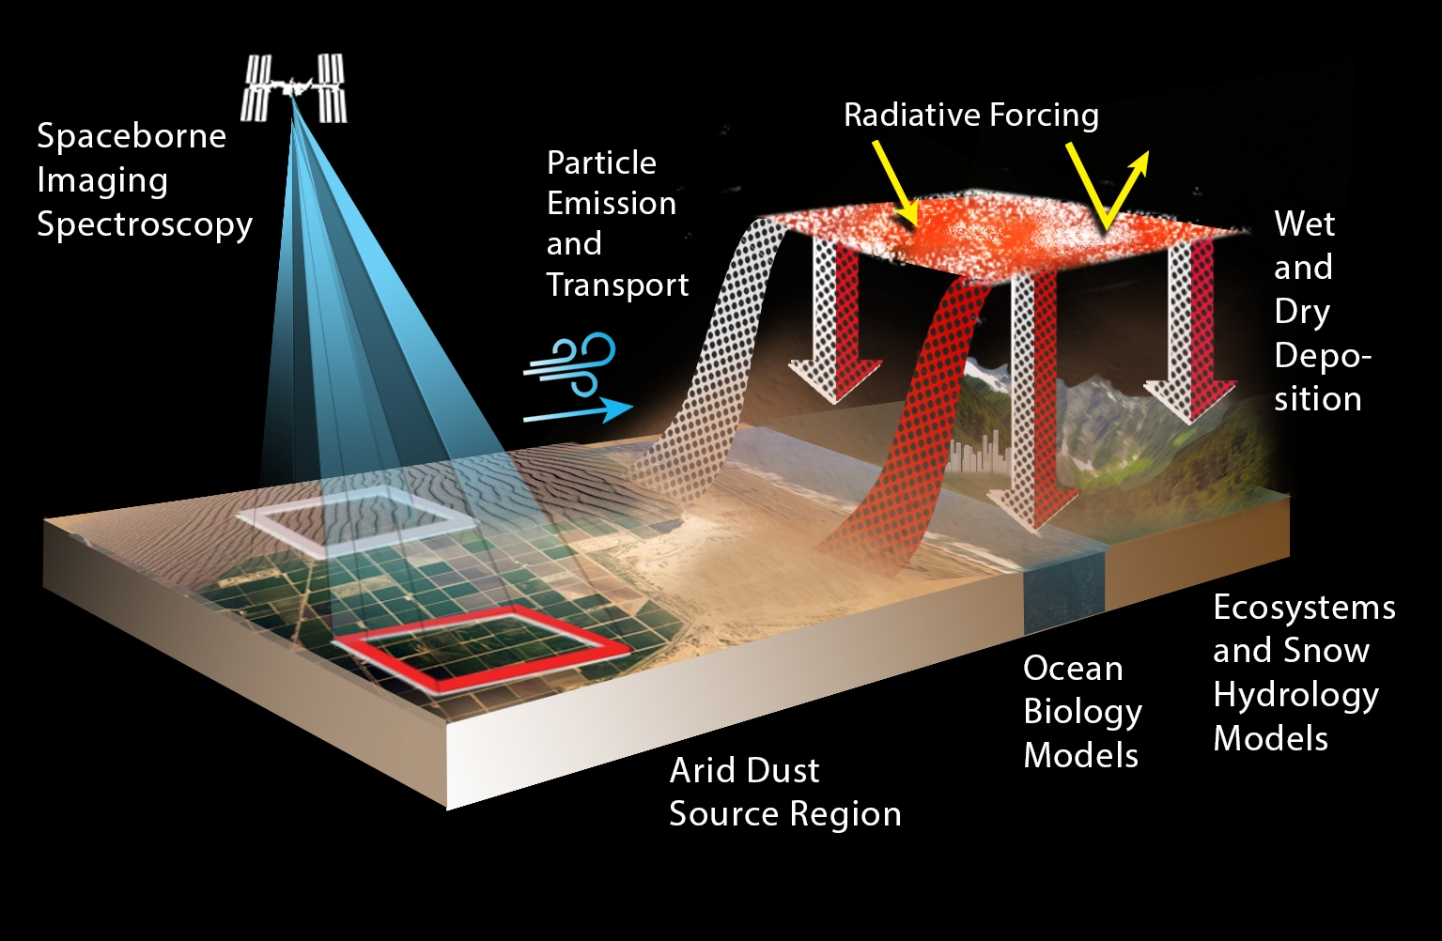
Launching 2021: EMIT
Image: NASA / JPL

Slide 17
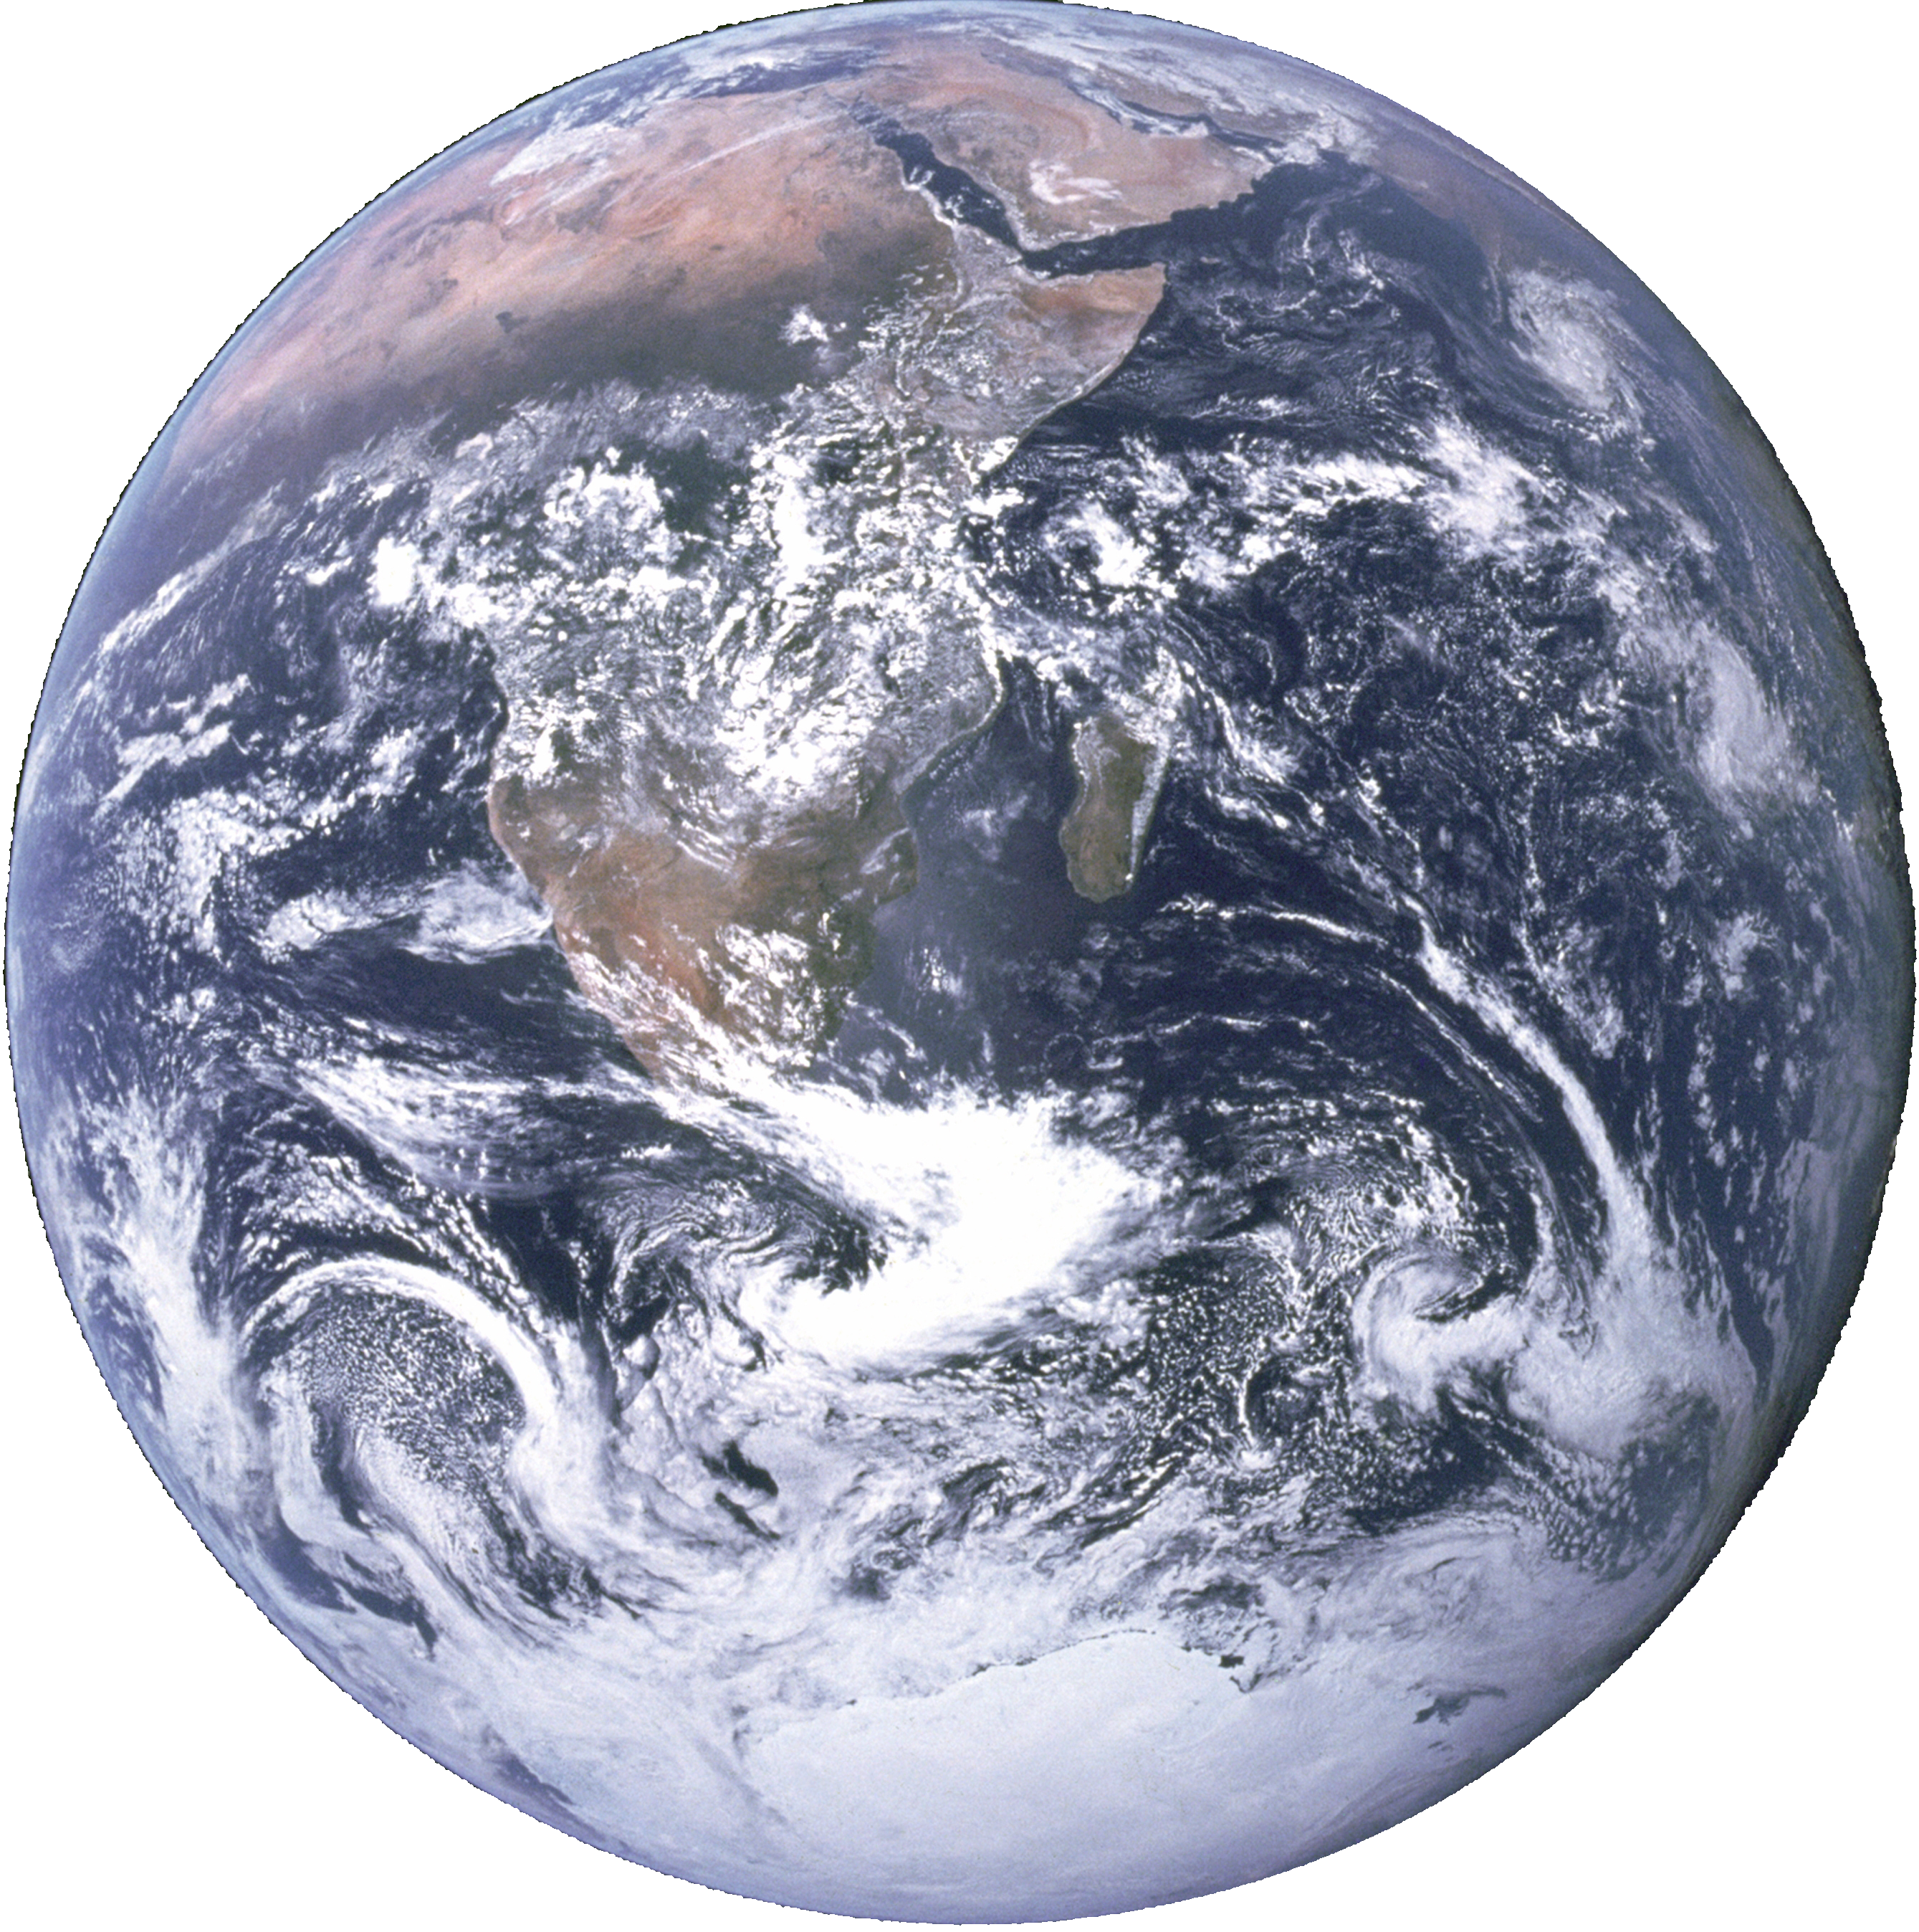
Recommended Decadal Survey Investigation: SBG (NASA)
Global VSWIR
Targeted VSWIR
Targeted VNIR
Upcoming orbital Investigations
EMIT (NASA)
ENMAP (DRL)
HISUI (Japan, METI)
AHSI (China)
Hyperion (NASA Pathfinder)
PRISMA (ISA)
HICO (ONR/NASA)
DESIS (DRL)
CHRIS/PROBA (ESA)
2000 2005 2010 2015 2020 2025 2030

Slide 19
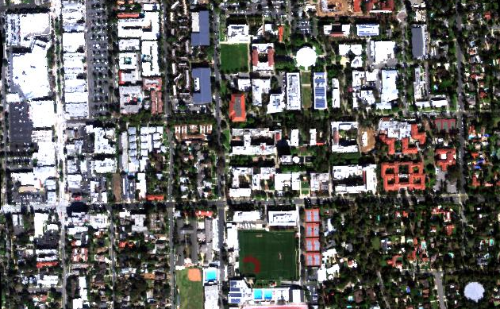
Exercise 1: Scavenger hunt
You have a data cube of reflectances acquired by the AVIRIS-NG instrument over the California Institute of Technology. Find the following spectra in the scene… what material(s) does each represent?
N
100 m

Slide 20
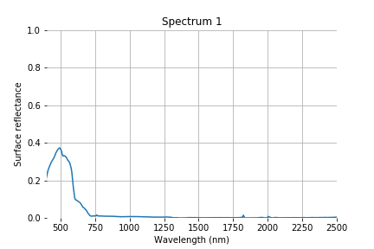
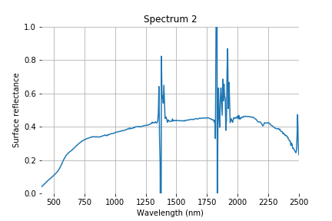
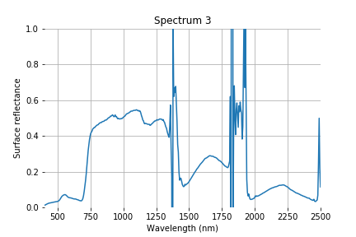
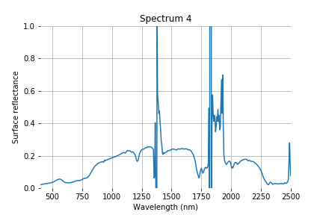
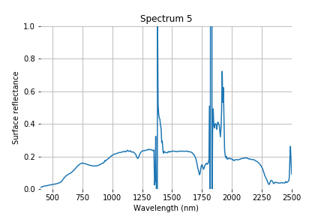
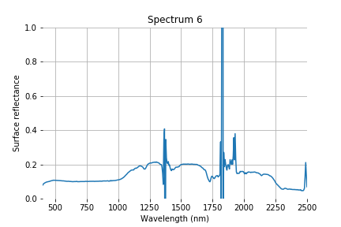
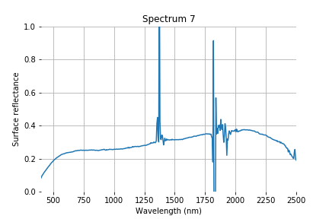
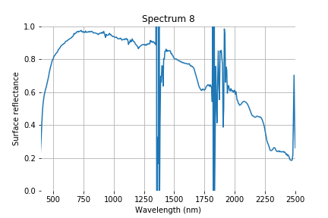
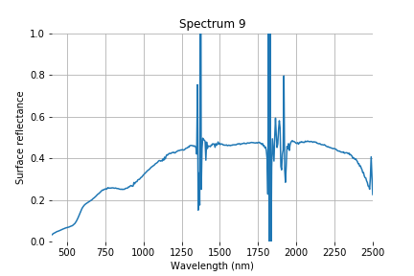
Targets

Slide 21
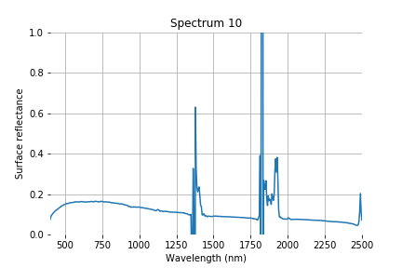
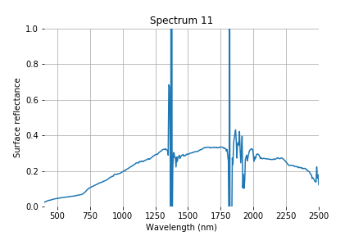
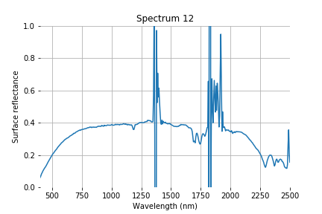
Targets

